Slide 1
ENCOR 446 CS sales tool

Slide 2

ENCOR 446 CS basic data
ENCOR 446 CS is a very low surfactant styrene acrylic latex for use in various construction and adhesive applications. It is useful in applications such as water-resistant construction adhesives and cement admixtures.
ENCOR® 446 CS features high dry-film adhesion to a variety of substrates, including low energy surfaces, and yields tough, flexible films. In addition, it has high solids (62%) and quick water release for fast drying.
Basic data
  Appearance： Milky white
  S.C.： 62%
  PH ： 6
  P.S.(um)： 0.3
  Viscosity (Brookfield, cP) <1000
  Tg ℃ 12
  MFFT ℃ 6
Typical applicatoin
  2K waterproofing mortar
  Interface agent
  Repair mortar
  CTA

Slide 3
JC/T 2090 starting formulation （9:25）
Liquid part
ENCOR 446 |  | 22
Water |  | 77.7
Foamaster NXZ |  | 0.3
Powder part：
P.O 42.5 cement |  | 45
Sand（70-140mesh） |  | 42.6
CaCO3（325mesh） |  | 12.5
M10 |  | 0.12
F10 |  | 0.2
L:P |  | 9:25
 |  | Results | JC/T 2090 I
Bonding strength/Mpa | Normal | 1.25 | ≥0.7
 | Alkali treatment | 1.32 | ≥0.7
 | Water treatment | 1.26 | ≥0.7
Flexural strength/MPa |  | 10.8 | ≥4
Compressive strength/MPa |  | 28 | ≥12

Slide 4
JC/T 984 starting formulation（3:10）
 |  | With CACO3
Liquid part：
ENCOR 446 |  | 32
Water |  | 67.8
Foamaster NXZ |  | 0.2
Powder part：
P.O 42.5 cement |  | 45
Sand （70-140mesh） |  | 35
CaCO3（325目） |  | 20
M10 |  | 0.05
F10 |  | 0.3
L:P |  | 3:10
 |  | Results | JC/T 984 I
Flowability/cm,0min |  | 26 | /
Bonding strength/Mpa | 7d | 1.98 | ≥0.8
 | 28d | 2.25 | ≥1
Compressive strength/MPa |  | 45.8 | ≥18
Flexural strength/MPa |  | 12.1 | ≥6
Water absorption/% |  | 3.81 | ≤6

Slide 5
ENCOR 446 CS water absorption
L:P=3:10 P:C=0.13

Slide 6
ENCOR 446 CS strength performance
L:P=3:10 P:C=0.13

Slide 7
JC/T 984 starting formulation（3:10）
 |  | Without CACO3
Liquid part：
ENCOR 446 |  | 27
Water |  | 72.7
Foamaster NXZ |  | 0.3
Powder part：
P.O 42.5 cement |  | 50
Sand（70-140mesh） |  | 50
M10 |  | 0.06
F10 |  | 0.25
L:P |  | 3:10
 |  | Results | JC/T 984 I
Flowability/cm,0min |  | 30.5 | /
Bonding strength/Mpa | 7d | 1.77 | ≥0.8
 | 28d | 2.02 | ≥1
Compressive strength/MPa |  | 36.6 | ≥18
Flexural strength/MPa |  | 13.2 | ≥6
Water absorption/% |  | 4.43 | ≤6

Slide 8
JC/T 984 starting formulation（1:4）
 |  | Without CaCO3 | With CaCO3
Liquid part：
ENCOR 446 |  | 35 | 35
Water |  | 64.7 | 64.7
Foamaster NXZ |  | 0.3 | 0.3
Powder part：
P.O 42.5 cement |  | 45 | 40
Sand（70-140mesh） |  | 54.7 | 50
CaCO3（325mesh） |  | 0 | 9.7
M10 |  | 0.04 | 0.04
F10 |  | 0.3 | 0.3
L:P |  | 1:4
 |  | Results |  | JC/T 984 I
Flowability/cm,0min |  | 133 | 135 | /
Bonding strength/Mpa | 7d | 1.38 | 1.37 | ≥0.8
 | 28d | 1.37 | 1.52 | ≥1
Compressive strength/MPa |  | 30 | 31.4 | ≥18
Flexural strength/MPa |  | 11.9 | 12.3 | ≥6
Water absorption/% |  | 5.7 | 5.84 | ≤6

Slide 9
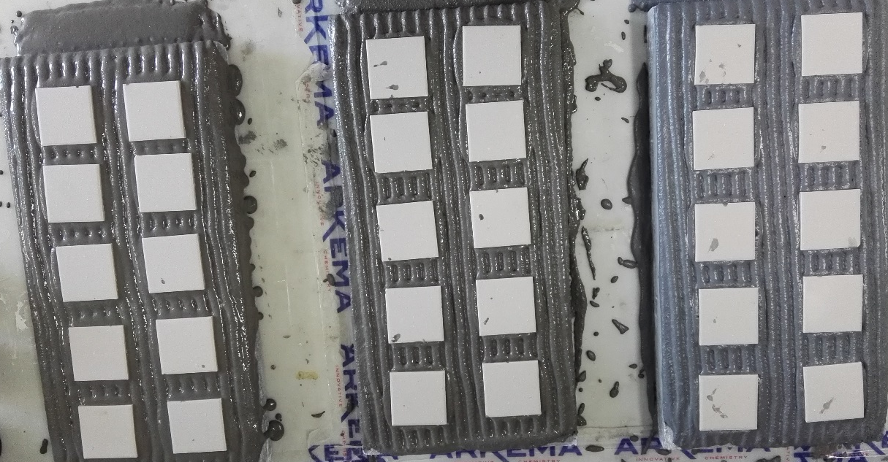
ENCOR 446 CS for CTA application
 | 30% ENCOR 446 | 35% ENCOR 446 | 30% Styrofan ECO 7623
Bonding strength/MPa | 1.05 | 1.3 | 1.21
Bonding strength after water treatment/MPa | 0.97 | 1.28 | 1.05

